Slide 1
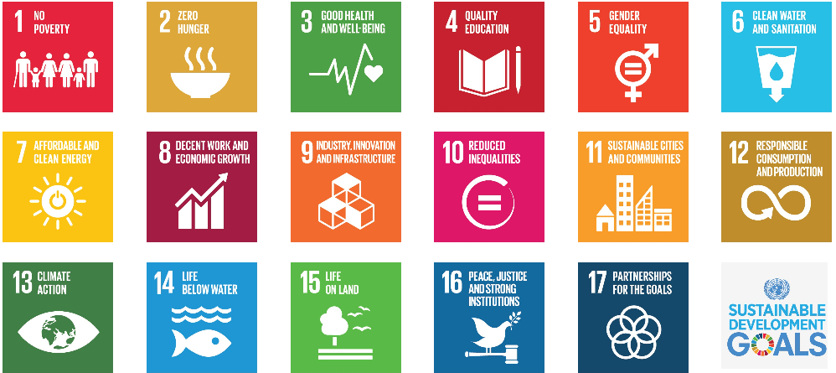
LOGO
Science and Technology Search Engine Search Box
Search Button
(#classification filter link buttons)

Slide 2
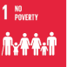


(#Science and Technology Search Engine Search Box)
Search Button
About 18,400 results (0.91 seconds)
SGD Filter
SDG 1
SDG 2
(#1 Hyperlink and anchor text) Sustainable energy - Wikipedia
(#1 Link) https://en.wikipedia.org/wiki/Sustainable_energy
(#the first sentence with most number of tagged SDG)Sustainable energy is energy that is consumed at insignificant rates compared to its supply and with manageable collateral effects….”
(#1 tags)SDG7: Energy; SDG9: Infrastructure…
SDG 3
……
(#2 Hyperlink and anchor text) Learning About Renewable Energy | NREL
(#2 Link) https://www.nrel.gov/workingwithus/learning.html
(#2 the first sentence with most number of tagged SDG) Provides information about renewable energy, energy efficiency practices, delivery and storage technologies, applications and student resources.
(#2 tags)SDG7: Energy; SDG11: Cities…

Slide 3
(#query)
Search Button
Related topic 1 About 17,500 results (#related topic)
SGD Filter
Related topic 2About 18,900 results
SDG 1
Related topic 3About 17,670 results
SDG 2
(#1 Hyperlink and anchor text) Sustainable energy - Wikipedia
(#1 Link) https://en.wikipedia.org/wiki/Sustainable_energy
(#the first sentence with most number of tagged SDG)Sustainable energy is energy that is consumed at insignificant rates compared to its supply and with manageable collateral effects….”
(#1 tags)SDG7: Energy; SDG9: Infrastructure…
SDG 3
……
(#2 Hyperlink and anchor text) Learning About Renewable Energy | NREL
(#2 Link) https://www.nrel.gov/workingwithus/learning.html
(#2 the first sentence with most number of tagged SDG) Provides information about renewable energy, energy efficiency practices, delivery and storage technologies, applications and student resources.
(#2 tags)SDG7: Energy; SDG11: Cities…

